Slide 1
Migrating SQL databases to Azure
Notes:
Information in this document, including URL and other Internet Web site references, is subject to change without notice. Unless otherwise noted, the example companies, organizations, products, domain names, e-mail addresses, logos, people, places, and events depicted herein are fictitious, and no association with any real company, organization, product, domain name, e-mail address, logo, person, place or event is intended or should be inferred. Complying with all applicable copyright laws is the responsibility of the user. Without limiting the rights under copyright, no part of this document may be reproduced, stored in or introduced into a retrieval system, or transmitted in any form or by any means (electronic, mechanical, photocopying, recording, or otherwise), or for any purpose, without the express written permission of Microsoft Corporation.
Microsoft may have patents, patent applications, trademarks, copyrights, or other intellectual property rights covering subject matter in this document. Except as expressly provided in any written license agreement from Microsoft, the furnishing of this document does not give you any license to these patents, trademarks, copyrights, or other intellectual property.
The names of manufacturers, products, or URLs are provided for informational purposes only and Microsoft makes no representations and warranties, either expressed, implied, or statutory, regarding these manufacturers or the use of the products with any Microsoft technologies. The inclusion of a manufacturer or product does not imply endorsement of Microsoft of the manufacturer or product. Links may be provided to third party sites. Such sites are not under the control of Microsoft and Microsoft is not responsible for the contents of any linked site or any link contained in a linked site, or any changes or updates to such sites. Microsoft is not responsible for webcasting or any other form of transmission received from any linked site. Microsoft is providing these links to you only as a convenience, and the inclusion of any link does not imply endorsement of Microsoft of the site or the products contained therein.
© 2018 Microsoft Corporation. All rights reserved. Microsoft and the trademarks listed at https://www.microsoft.com/en-us/legal/intellectualproperty/Trademarks/Usage/General.aspx are trademarks of the Microsoft group of companies. All other trademarks are property of their respective owners.

Slide 2
Abstract and learning objectives
In this whiteboard design session, you will work in a group to develop a plan for migrating on-premises VMs and SQL Server 2008 R2 databases into a combination of IaaS and PaaS services in Azure. You will provide guidance on performing assessments to reveal any feature parity and compatibility issues between the customer's SQL Server 2008 R2 databases and the managed database offerings in Azure. You will then design a solution for migrating their on-premises services, including VMs and databases, into Azure, with minimal or no down-time. Finally, you will provide guidance on how to enable some of the advanced SQL features available in Azure to improve security and performance in the customer's applications.
At the end of this whiteboard design session, you will be better able to design a cloud migration solution for business-critical applications and databases.
Notes:
This is an introduction to the Cloud Workshop at a high level. Later we’ll get into customer objections, requirements, etc., but we want to ground the participants on the business outcomes we’re going after for the day.

Slide 3
Step 1: Review the customer case study
Outcome
Analyze your customer needs.
Timeframe
15 minutes

Slide 4
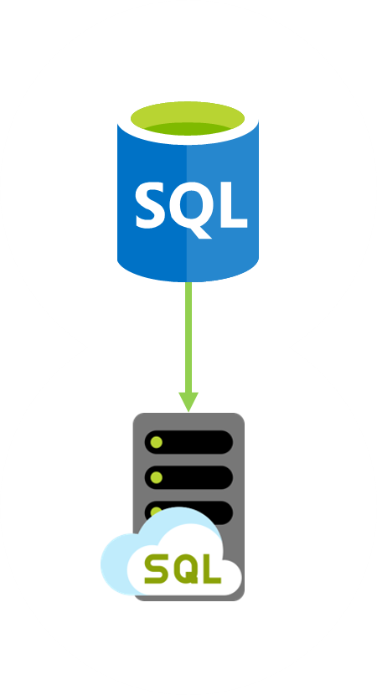
Customer situation
Tailspin Toys is online gaming company experiencing exponential growth
Struggling to manage expanding database infrastructure
Lacking ability to scale
Looking to migrate gaming services to the cloud

Slide 5
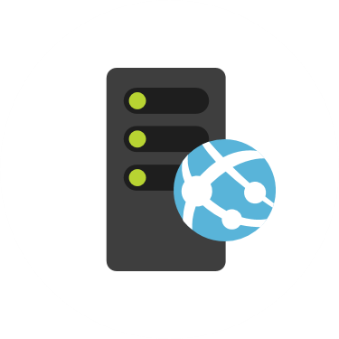
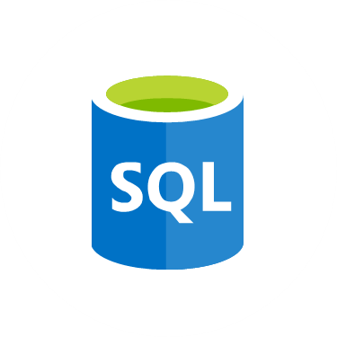
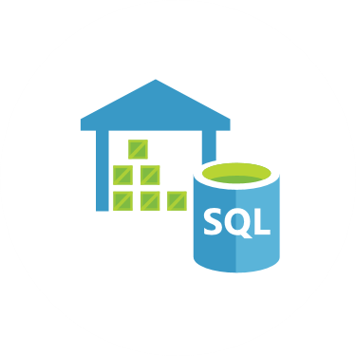
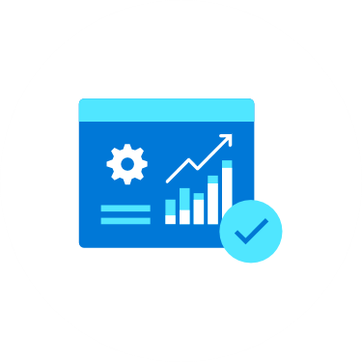
Customer situation
Gaming
Service
VMs
SQL 2008
Databases
Data
Warehouse
Reports
Notes:
Gaming services and authentication VMs
Lift-and-shift
Gaming databases
SQL Server 2008 R2
Looking at PaaS if possible
Running Service broker feature
Data warehouse
SQL Server 2008 R2
Lots of reports
Direct connections by developers and customer service
Data fed via SSIS jobs, hourly
Reports
SSAS cubes feed reports
SSRS reports
Sent to SharePoint

Slide 6

Customer needs
Migrate all gaming services into cloud
Move data warehouse and associated services to cloud
Want to minimize migration costs

Slide 7
Customer needs
Looking to improve database security
Want to improve gamer experience
Disaster recovery from regional outage

Slide 8

Customer objections
Looking for comparison of SQL database hosting options in Azure.
What tools can help a evaluate databases against target platforms and identify potential issues?
Can we have network isolation and secure channel access from on-premises?
Don’t want to be locked into a cloud vendor.

Slide 9

Common scenarios
Notes:
This is a diagram of a common architecture for this type of scenario, from which you can draw inspiration. You will find this diagram within the Whiteboard Design Session Student Guide.

Slide 10
Step 2: Design the solution
Outcome
Design a solution and prepare to present the solution to the target customer audience in a 15-minute chalk-talk format.
Timeframe
60 minutes
Business needs (10 minutes) | Respond to questions outlined in your guide and list the answers on a flipchart
Design (35 minutes) | Design a solution for as many of the stated requirements as time allows. Show the solution on a flipchart
Prepare (15 minutes) | Identify any customer needs that are not addressed with the proposed solution Identify the benefits of your solution Determine how you will respond to the customer’s objections Prepare for a 15-minute presentation to the customer

Slide 11
Step 3: Present the solution
Outcome
Present a solution to the target customer in a 15-minute chalk-talk format
Timeframe
30 minutes (15 minutes for each team to present and receive feedback)
Directions
Pair with another table.
One table is the Microsoft team and the other table is the customer.
The Microsoft team presents their proposed solution to the customer.
The customer asks one of the objections from the list of objections in the case study.
The Microsoft team responds to the objection.
The customer team gives feedback to the Microsoft team.

Slide 12
Wrap-up
Outcome
Identify the preferred solution for the case study.
Identify solutions designed by other teams.
Timeframe
15 minutes

Slide 13

Preferred target audience
Molly Fischer, CIO of Tailspin Toys
Primary audience is business and technology decision makers.
Usually talk to infrastructure managers who report to the CIO or application sponsors (like a VP LOB, CMO) or those that represent the business unit IT or developers that report to application sponsors.

Slide 14
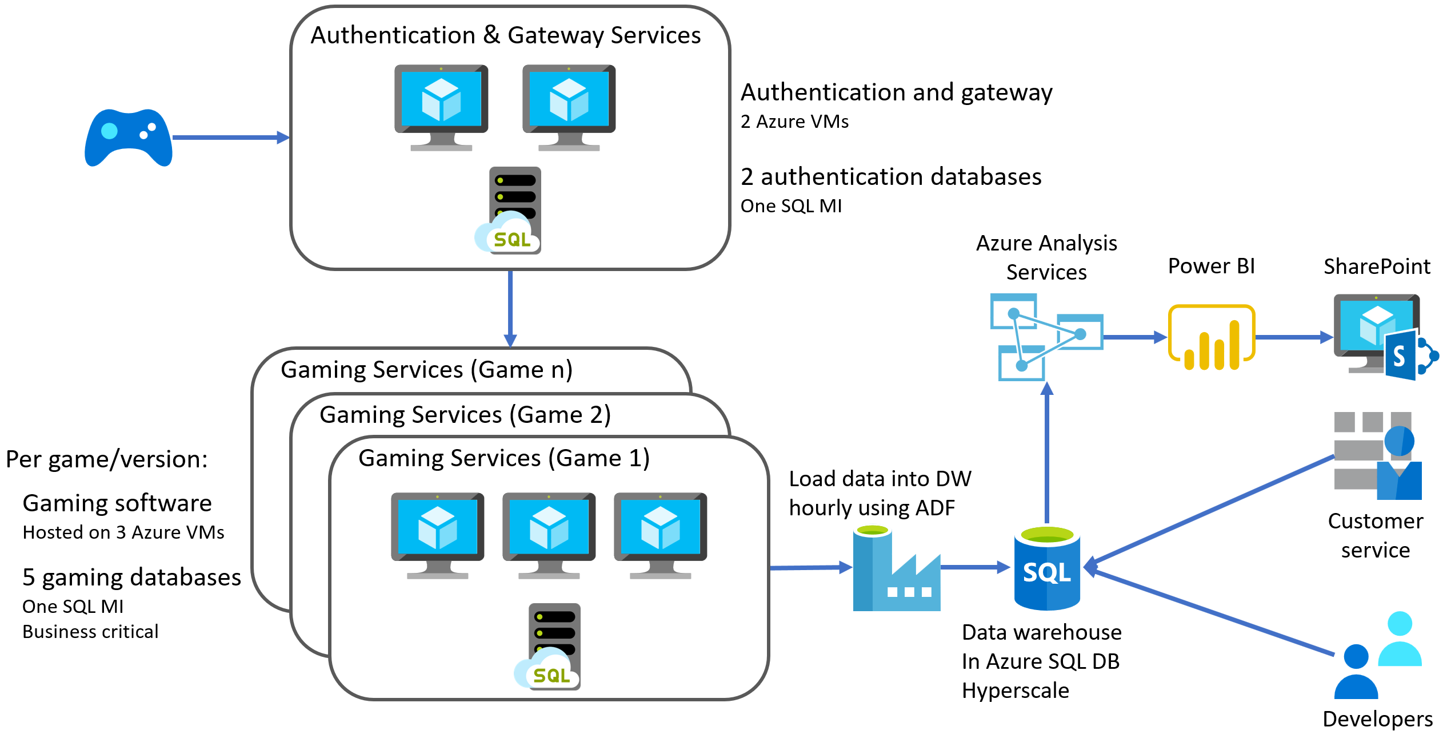
Preferred solution
Notes:
The preferred solution is just one of many viable options.

Slide 15


Preferred solution
Azure Hybrid Benefit
Prepay for reserved capacity
Azure Database Migration Service
Azure Site Recovery
Partner engagement
Notes:
Cost minimization
Azure Hybrid Benefit
Reserved capacity payments
DMS
3 month timeframe
DMS
ASR
Partner engagement
Dedicated resources

Slide 16
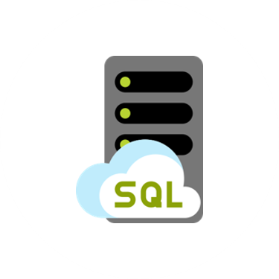

Preferred solution - PoC
Gaming
Service
VMs
SQL MI
Databases
SQL DB
Hyperscale
Data
Warehouse
Power BI
Reports
Notes:
Gaming services and authentication VMs for 1 game
Gaming and auth databases
SQL MI Business critical for games, and GP for auth
Data warehouse
SQL DB Hyperscale
ADF to replace SSIS packages
Reports
Azure Analysis Services
Power BI

Slide 17
Preferred solution – IaaS vs PaaS
Cost
Administration
SLAs
Time to move

Slide 18

Preferred solution – Recommended database
Azure SQL Database Managed Instance
Platform-as-a-Service (PaaS)
Supports database migration from on-premises with minimal to no database changes
Provides all of the PaaS benefits of Azure SQL Database but adds capabilities that were previously only available in SQL VMs
Includes a native virtual network (VNet) and near 100% compatibility with on-premises SQL Server
Notes:
Managed instance is a new deployment option of Azure SQL Database, providing near 100% compatibility with the latest SQL Server on-premises (Enterprise Edition) Database Engine.
Provides a native virtual network (VNet) implementation that addresses common security concerns, and a business model favorable for on-premises SQL Server customers.
The managed instance deployment model allows existing SQL Server customers to lift and shift their on-premises applications to the cloud with minimal application and database changes.
At the same time, the managed instance deployment option preserves all PaaS capabilities (automatic patching and version updates, automated backups, high-availability ), that drastically reduces management overhead and TCO.
Adds features that are not available in Azure SQL Database, such as cross-database queries, linked servers, CLR modules, and Service Broker.

Slide 19
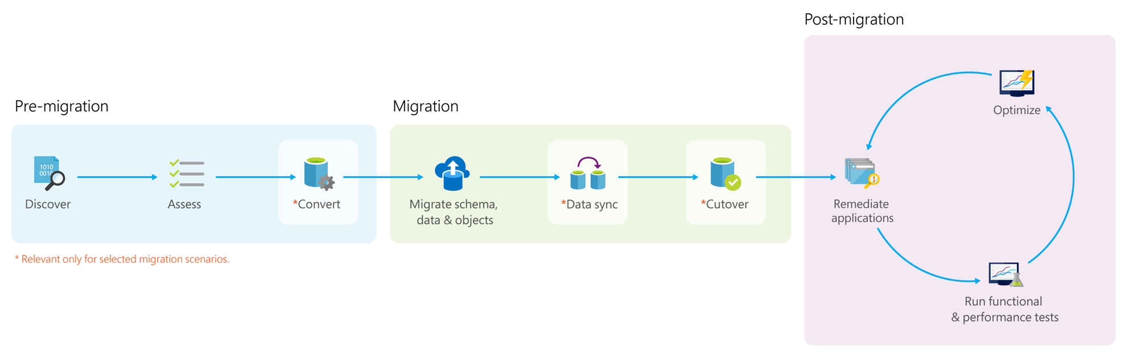
Preferred solution – Data migration
Notes:
*Pre-migration*:
- **Discover**: Inventory your source database assets and perform an application stack discovery.
- **Assess**: Assess source workloads and fix recommendations.
- **Convert**: Convert the source schema to work in the target environment. This is only relevant for heterogeneous migrations.
*Migration*:
- **Migrate schema, data, and objects**: Migrate the source schema and then migrate the source data to the target.
- **Sync data**: Sync your target schema and data with the source. This is only relevant for minimal-downtime migrations.
- **Cutover**: Cut over from the source to the target environment. This is only relevant for minimal-downtime migrations.
*Post-migration*:
- **Remediate applications**: Iteratively make any necessary changes to your applications.
- **Perform Tests**: Iteratively run functional and performance tests.
- **Optimize**: Based on the tests you performed, address any performance issues and then retest to confirm the performance improvements.

Slide 20
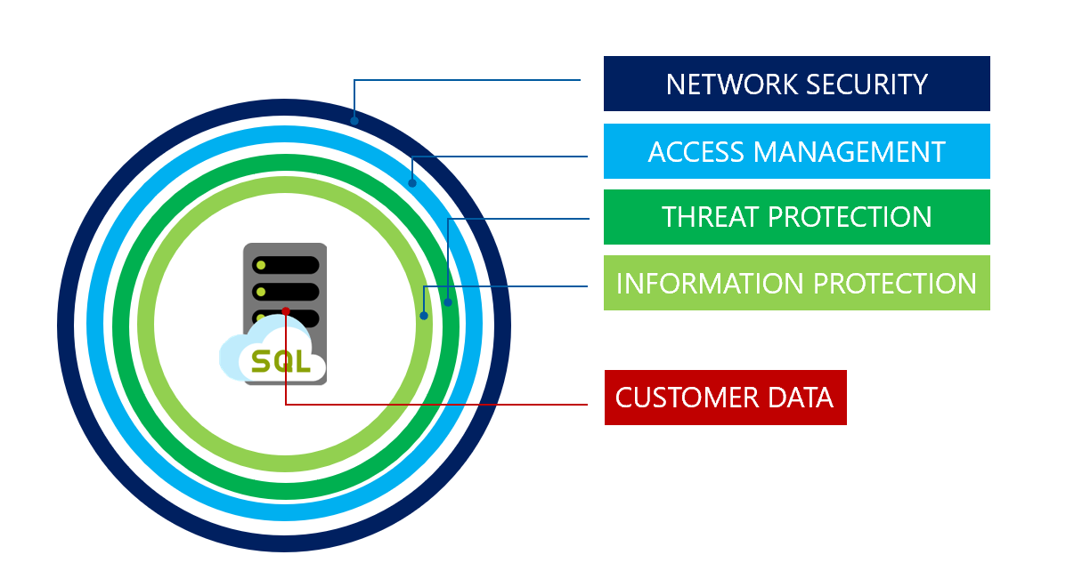
Preferred solution – Database security
Notes:
SQL MI includes numerous security tools that could be leveraged by Tailspin Toys, including:
SQL Database Advance Data Security
SQL Data Discovery and Classification
SQL Vulnerability Assessment service
Advanced Threat Detection
Transparent Data Encryption
Dynamic Data Masking
Row-level security

Slide 21
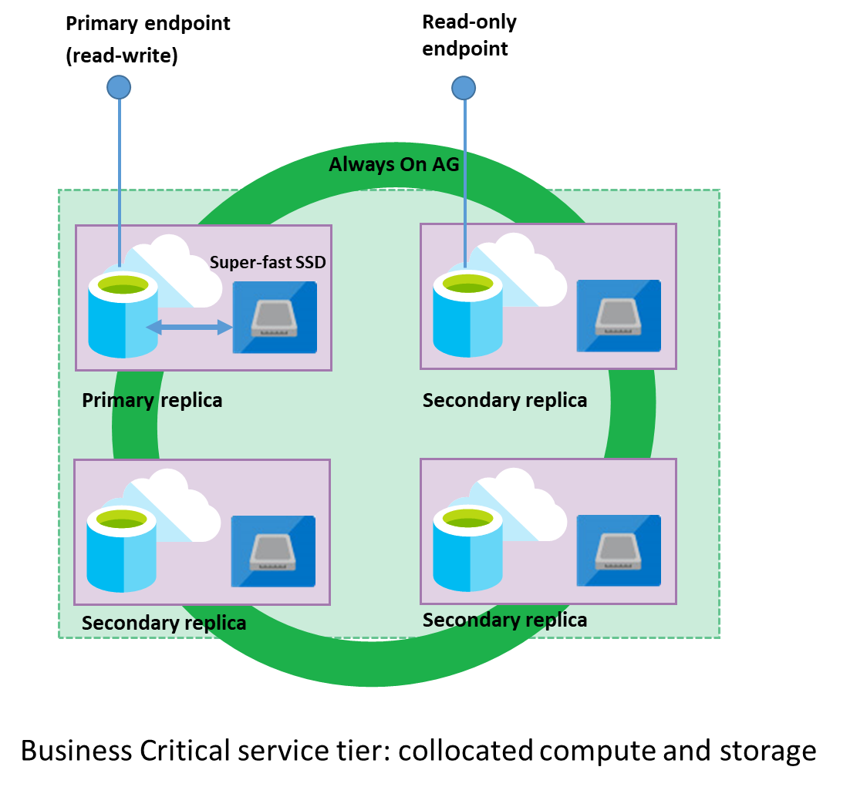
Preferred solution – Read-only reporting
Read Scale-out
Read-only replica
Free with SQL MI BC

Slide 22
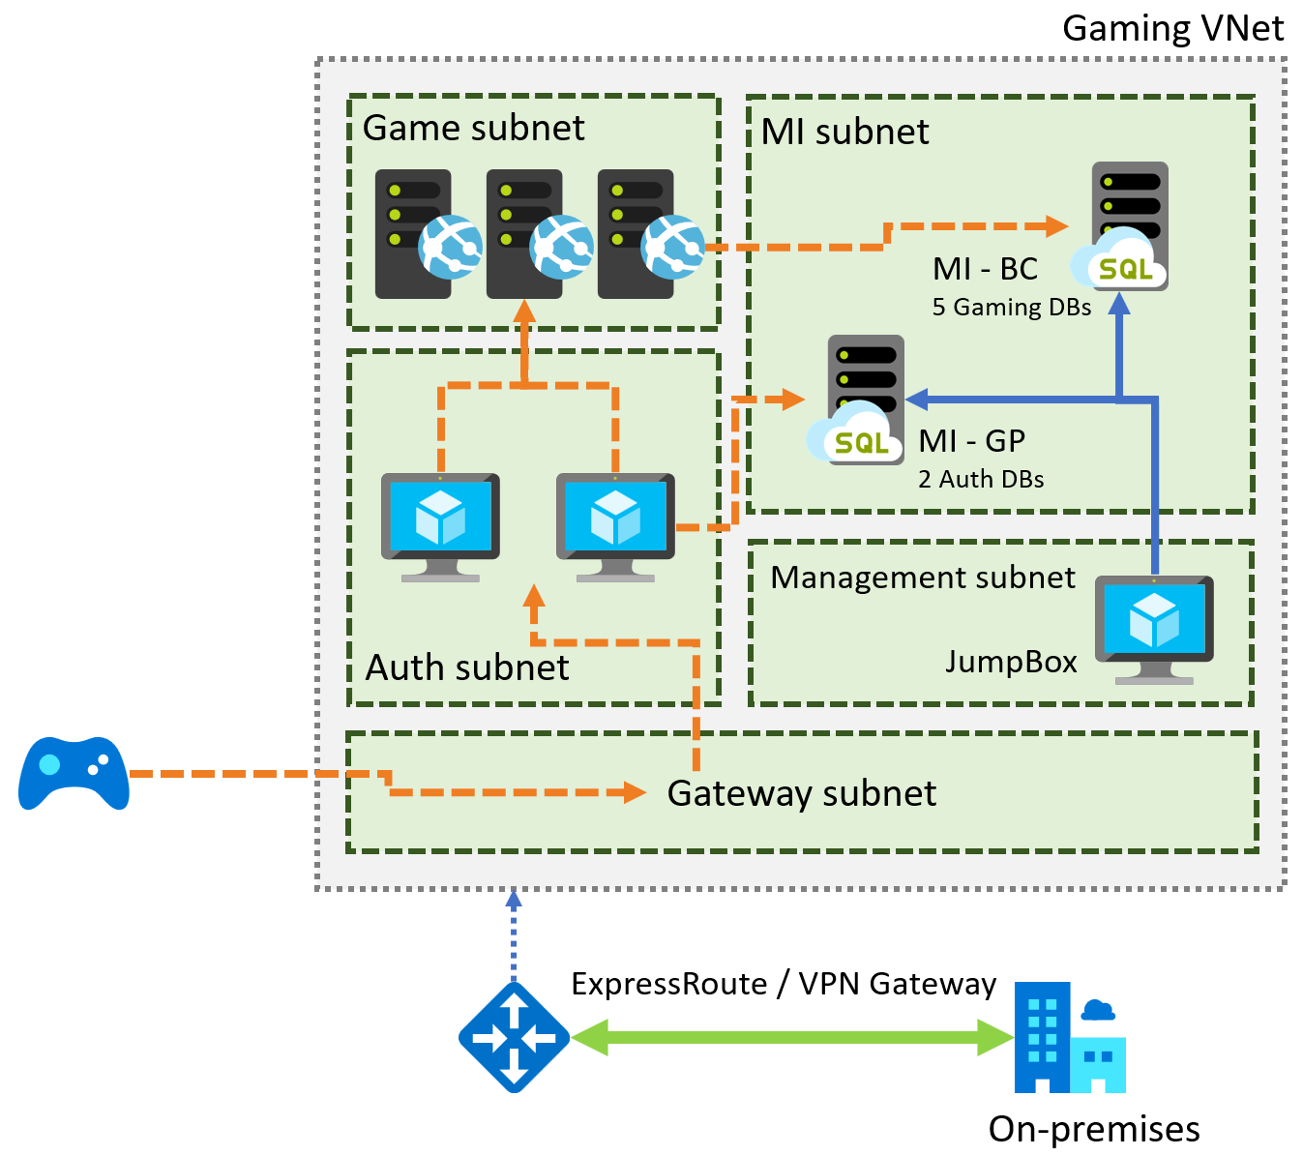
Preferred solution – Gaming services
Notes:
Diagram of the preferred solution for the gaming services. The gaming services are hosted in a VNet, with subnets for MI, Game, Management, Auth, and a Gateway subnet. SQL MI instances are hosted in the MI subnet. Gaming IaaS VMs are hosted in the Game subnet. Authorization VMs are in the Auth subnet, and a JumpBox is in the Management subnet. On-premises resources can access the VNet through ExpressRoute or a VPN gateway.

Slide 23
Preferred solution – Gaming services
Azure Site Recovery to migrate VMs
Multi-region deployments to address latency
VM scale sets for scalability of VMs
Availability Zones for high-availability

Slide 24
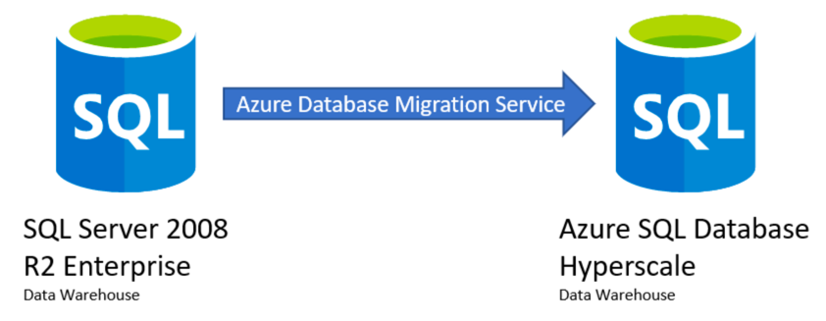
Preferred solution – Data warehouse + reporting
Notes:
Migrate to Azure SQL DB Hyperscale
Current database 20TB, and growing by 250GB monthly
Many concurrent users
Read-scale out requests with the recommended platform for a data warehouse of their size and user count
For their data warehouse they could use either Azure SQL Data Warehouse or Azure SQL Database (Hyperscale service tier). The Hyperscale service tier is required due to the large size of their existing data warehouse.
Given the customer's requirements, migrating to Azure SQL Database Hyperscale service tier is the recommended approach. This would provide maximum compatibility with their existing SQL Server 2008 R2 data warehouse, without needing to make any architectural changes. With the customer's current lack of real DBA skills, this would simplify the migration. Migrating to SQL DW, on the other hand, could require some re-architecting. In addition, the customer stated that their developers and customer service personnel connect directly to the data warehouse for reporting, troubleshooting, and other activities. SQL DW only allows 32 concurrent queries, so this could cause issues if a lot of users are hitting the data warehouse concurrently.

Slide 25
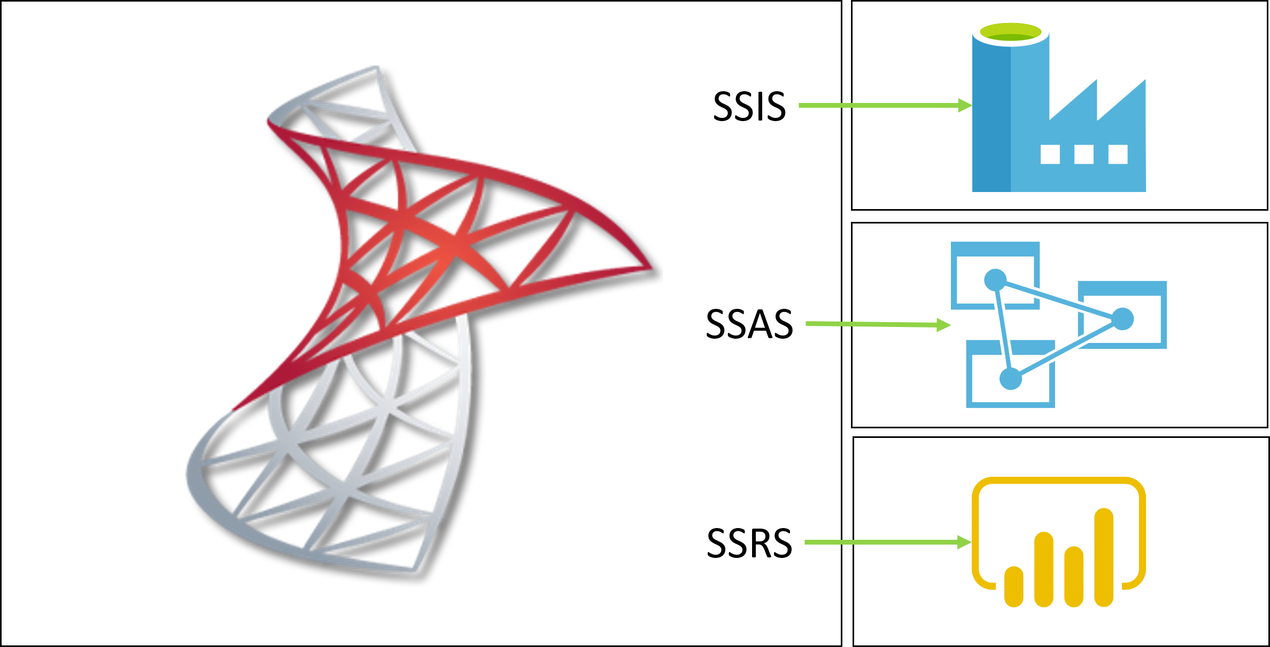
Preferred solution – Data warehouse + reporting
Notes:
SSIS
SSIS will be replaced with the Azure-SSIS Integration Runtime in Azure Data Factory. Typically, SSIS packages can be moved into ADF using a simple lift-and-shift approach using SQL Server Data Tools (SSDT) or SQL Server Management Studio (SSMS) to deploy and run the SSIS packages.
Alternatively, SSIS could be deployed using SQL Server on an Azure VM.
SSAS cubes
Azure Analysis Services (Azure AS) is a PaaS version of SSAS on-premises.
Tabular models can be migrated from SSAS to Azure AS using Visual Studio.
Alternatively, SSAS could be deployed using SQL Server on an Azure VM.
SSRS
There isn't a PaaS equivalent of SSRS, so they would either need to run SSRS on an Azure VM (IaaS), or their reports can be rewritten around Microsoft Power BI reporting capabilities.

Slide 26
Preferred solution – Regional outages
Availability Zones for VMs
Auto-failover groups in SQL MI (in public preview)
Geo-restore and geo-replication for DW
Notes:
NOTE: Auto-failover groups for Managed Instance is currently in public preview. For customers who object to using a preview feature, a manual failover process would need to be implemented. This could involve setting up transactional replication to another SQL MI in a different region. VNet peering would need to be established between the virtual networks.

Slide 27
Preferred objections handling

Slide 28
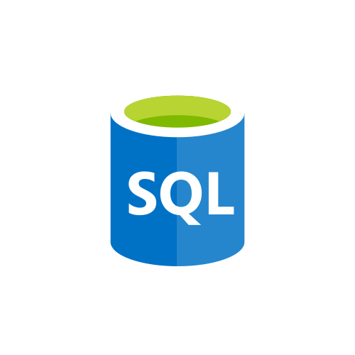
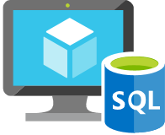

Options for running SQL databases on Azure
SQL Server on VM
Easily migrate your SQL Server workloads to the cloud
Azure SQL Database Managed Instance
Fully-managed SQL Server Database Engine Instance
Azure SQL Database
General-purpose relational database-as-a-service (DBaaS)
Notes:
The Azure SQL data platform consists of three options:
SQL Server on an Azure VM
Azure SQL Database Managed Instance
Azure SQL Database
Each of the options will be discussed in more detail in the slides that follow.

Slide 29

Comparing the three
Resources
Compatibility
Best for
SQL Server on VM
Existing applications that require fast migration to the cloud with minimal or no changes.
You need full admin rights
Up to 64 TB of storage
You have some IT resources for configuration and management
Supports all on-premises capabilities
New applications or existing on-premises apps that use the latest SQL Server features and are migrated to the cloud with minimal changes.
Don’t want to manage underlying OS and configuration
Databases up to 8 TB
SQL MI
Supports almost all on-premises instance-level and database-level capabilities
You do not want to employ IT resources for configuration and management
SQL DB
New cloud-designed applications that want to use the latest stable SQL Server features
Don’t want to manage underlying OS and configuration
Databases up to 100 TB (Hyperscale)
You do not want to employ IT resources for configuration and management
Supports most on-premises database-level capabilities
Notes:
In Azure, you can have your SQL Server workloads running in a hosted infrastructure (IaaS) or running as a hosted service (PaaS).
Within PaaS, you have multiple deployment options and service tiers within each deployment option.
The key question that you need to ask when deciding between PaaS or IaaS is do you want to manage your database, apply patches, take backups, or you want to delegate these operations to Azure?

Slide 30


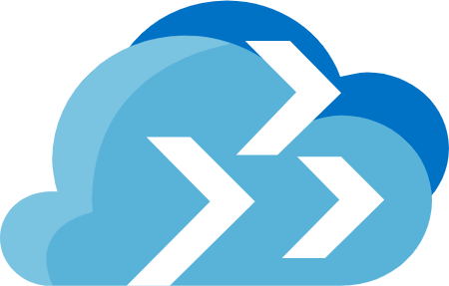

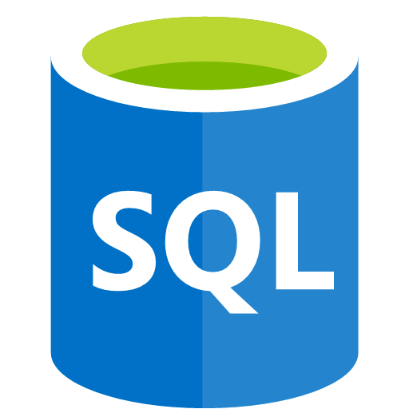
Upgrade & migration tools
Database Experimentation Assistant
Experimentation solution for SQL Server upgrades
Database Migration Assistant
Easily upgrade to a modern data platform
Azure Database Migration Service
Accelerate your transition to the cloud
SQL Server Migration Assistant
Automated migration to SQL Server
Notes:
The Azure SQL data platform consists of three options:
SQL Server on an Azure VM
Azure SQL Database Managed Instance
Azure SQL Database
Each of the options will be discussed in more detail in the slides that follow.

Slide 31


Network isolation
Notes:
SQL MI is deployed into an isolated Vnet
Subnets are used to allow access to SQL MI
On-premises access can be granted through ExpressRoute or a VPN Gateway

Slide 32
Cloud vendor lock-in
PaaS database services can be used
Use transactional replication to move data out

Slide 33
Customer quote
"With Azure SQL Database Managed Instance and the Azure Database Migration Service, we were able to migrate our database workloads into the cloud with minimal downtime and we have found a reliable, fully-managed cloud database that allows us to focus our efforts on adding business value, without having to worry about maintaining the underlying server hardware and operating systems."
- Molly Fischer, CIO of Tailspin Toys

